Slide 1
The end of reconstruction
Jim Crow Laws in the South

Slide 2
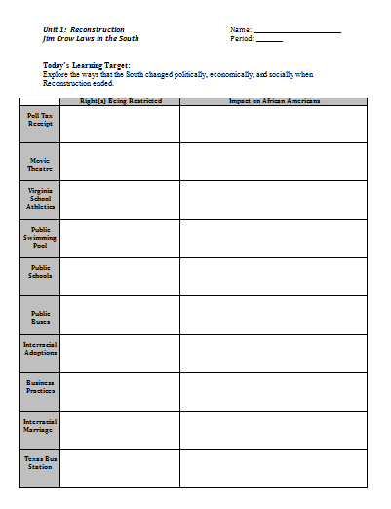
PowerPoint Graphic Organizer
Right(s) Being Restricted: Civil Liberties that are Being Denied…
Impact on African Americans: Long-term and Short-term effects of Jim Crow Laws…

Slide 3
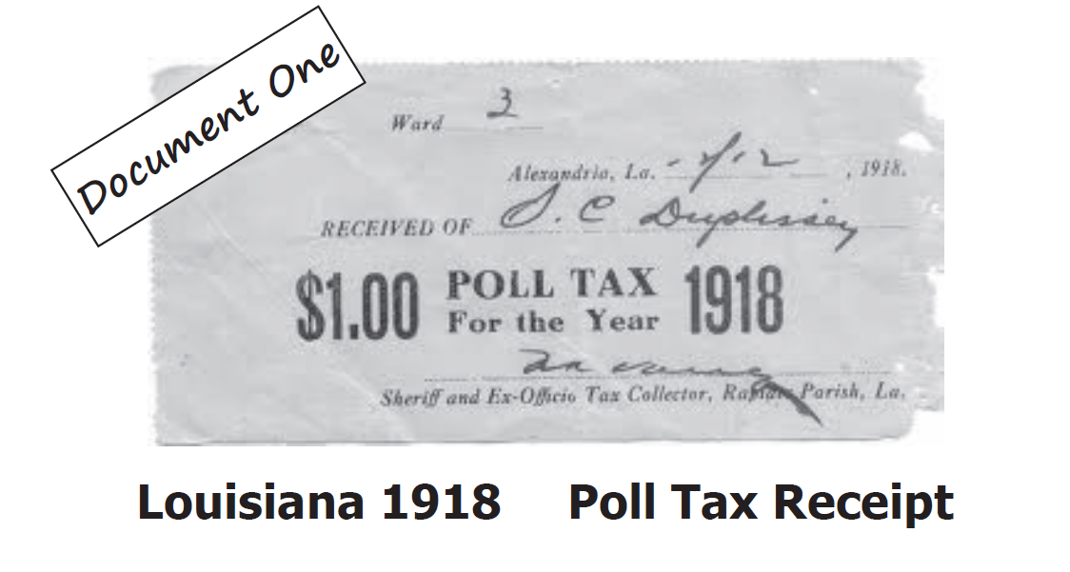

Slide 5
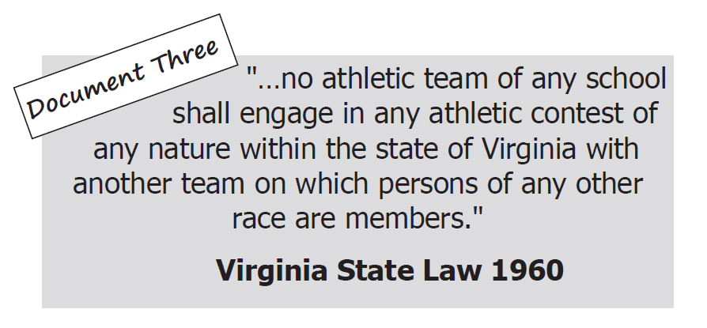

Slide 6
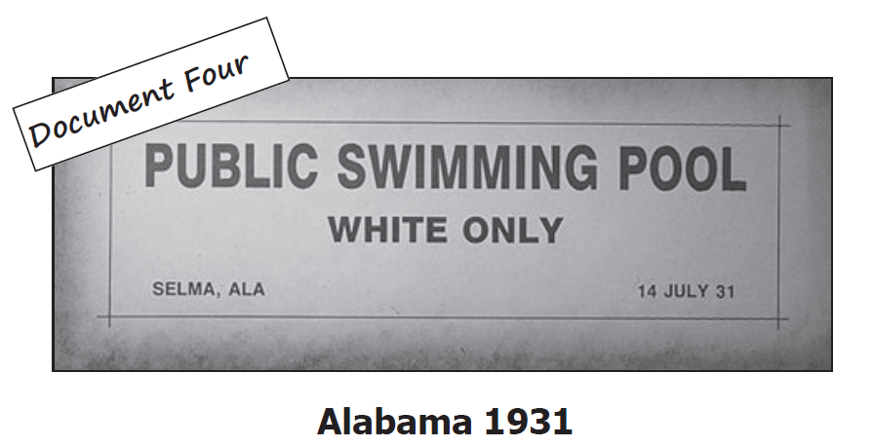

Slide 8
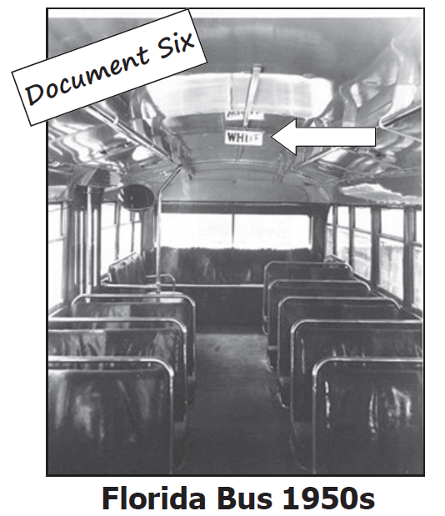

Slide 10
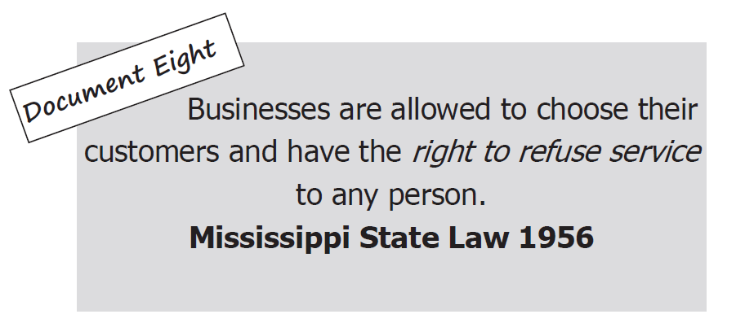

Slide 11
